Slide 1
Chapter 3
Relational Model and Algebra

Slide 2
Outline:
Introduction
Mapping ER and EER Model to Relational Model
Data Manipulation
Data Integrity
Advantages of the Relational Model
Relational Algebra & it Queries
Relational Calculus

Slide 3
Introduction to Relational Model

Slide 4
The Relational Model
Was introduced in 1970 by Dr. E. F. Codd (of IBM)
Commercial relational databases began to appear in the 1980s
Today relational databases have become the dominant technology for database management

Slide 5
The Relational Model
Data is represented in the form of tables, and the model has 3 components:
Data structure – data are organised in the form of tables with rows and columns
Data manipulation – powerful operations (using the SQL language) are used to manipulate data stored in the relations
Data integrity – facilities are included to specify business rules that maintain the integrity of data when they are manipulated

Slide 6
Basic Structure
Formally, given sets D₁, D₂, …. D_{n} a relation r is a subset of
D₁ x D₂ x … x D_{n}
Thus, a relation is a set of n-tuples (a₁, a₂, …, a_{n}) where each a_{i} ∈ D_{i}
Example: If
  customer_name = {Jones, Smith, Curry, Lindsay, …} /* Set of all customer names */
  customer_street = {Main, North, Park, …} /* set of all street names*/
  customer_city = {Harrison, Rye, Pittsfield, …} /* set of all city names */
  Then r = { (Jones, Main, Harrison),
  (Smith, North, Rye),
  (Curry, North, Rye),
  (Lindsay, Park, Pittsfield) }
  is a relation over
customer_name x customer_street x customer_city

Slide 7
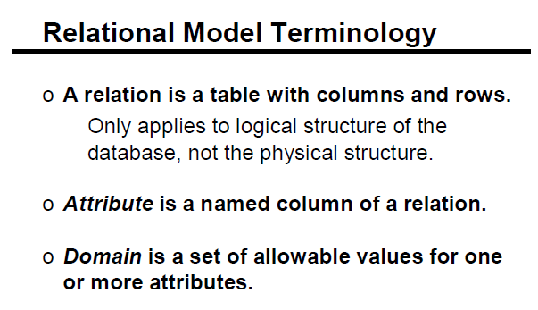

Slide 8
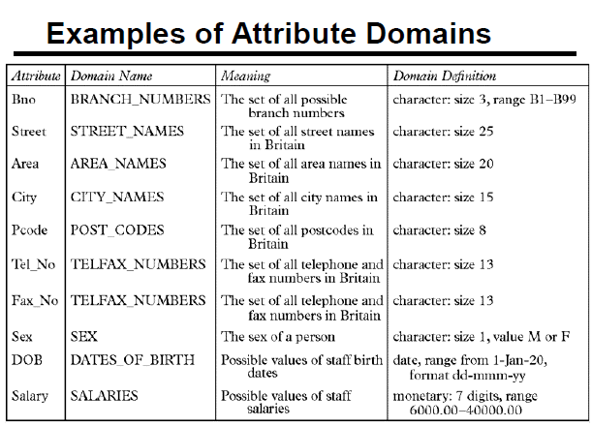

Slide 9
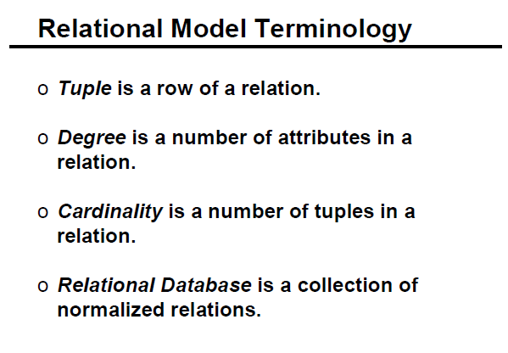

Slide 10
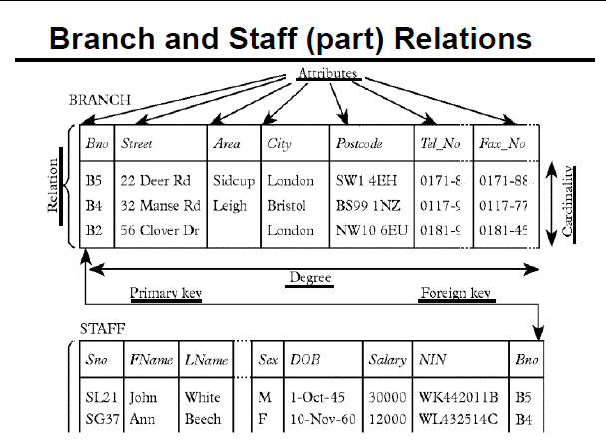
Concept: Example of a Relation

Slide 11
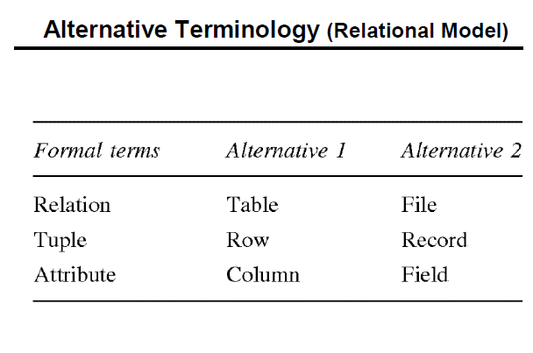

Slide 12
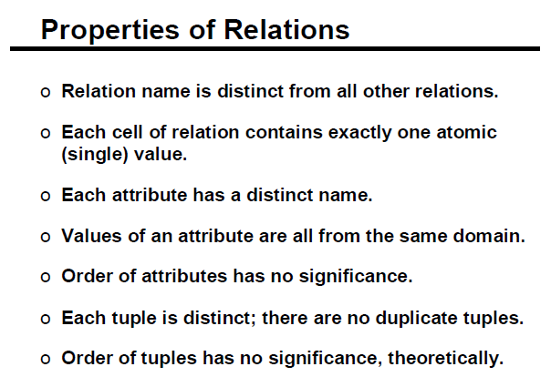

Slide 13
Relational Database Design by ER-to-Relational Mapping

Slide 14
Outline
ER-to-Relational Mapping Algorithm
Step 1: Mapping of Regular Entity Types
Step 2: Mapping of Weak Entity Types
Step 3: Mapping of Binary 1:1 Relation Types
Step 4: Mapping of Binary 1:N Relationship Types.
Step 5: Mapping of Binary M:N Relationship Types.
Step 6: Mapping of Multivalued attributes.
Step 7: Mapping of N-ary Relationship Types.

Slide 15

FIGURE 1.
The ER conceptual schema diagram for the COMPANY database.

Slide 16
ER-to-Relational Mapping Algorithm
Step 1: Mapping of Regular Entity Types.
  For each regular (strong) entity type E in the ER schema, create a relation R that includes all the simple attributes of E.
  Include only the simple component attributes of a composite attribute.
  Choose one of the key attributes of E as the primary key for R.
  If the chosen key of E is composite, the set of simple attributes that form it will together form the primary key of R.
  If multiple P.K’s are present for any E, the information describing the attributes that form each additional key is kept in order to specify secondary (unique) keys of relation R.
  Example: We create the relations EMPLOYEE, DEPARTMENT, and PROJECT in the relational schema corresponding to the regular entities in the ER diagram. SSN, DNUMBER, and PNUMBER are the primary keys for the relations EMPLOYEE, DEPARTMENT, and PROJECT as shown.

Slide 17
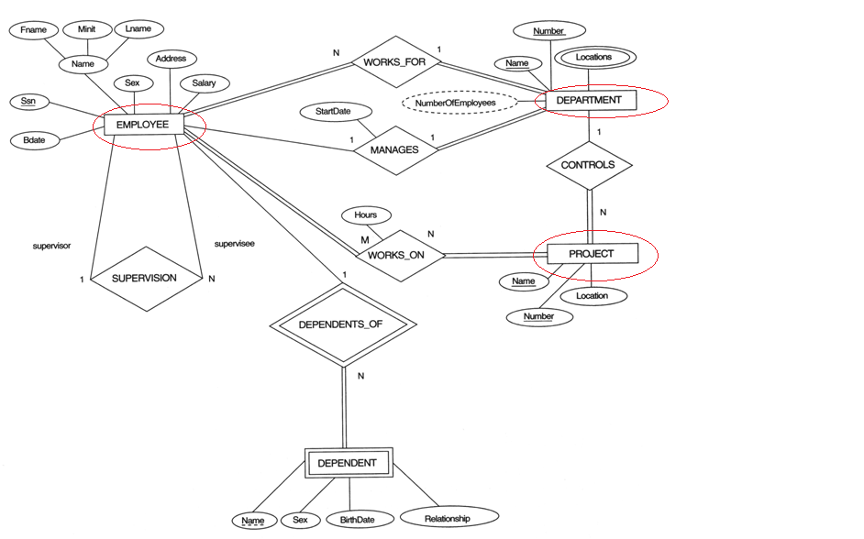
FIGURE 1.1 Mapping regular Entities

Slide 18
ER-to-Relational Mapping Algorithm (cont)
Step 2: Mapping of Weak Entity Types
  For each weak entity type W in the ER schema with owner entity type E, create a relation R and include all simple attributes (or simple components of composite attributes) of W as attributes of R.
  In addition, include the P.K attribute of the owner entity E, as foreign key attribute of R.
  The primary key of R is the combination of the primary key(s) of the owner(s) and the partial key of the weak entity type W, if any.
  Example: Create the relation DEPENDENT in this step to correspond to the weak entity type DEPENDENT. Include the primary key SSN of the EMPLOYEE relation as a foreign key attribute of DEPENDENT (renamed to ESSN).
  The primary key of the DEPENDENT relation is the combination {ESSN, DEPENDENT_NAME} because DEPENDENT_NAME is the partial key of DEPENDENT.

Slide 19
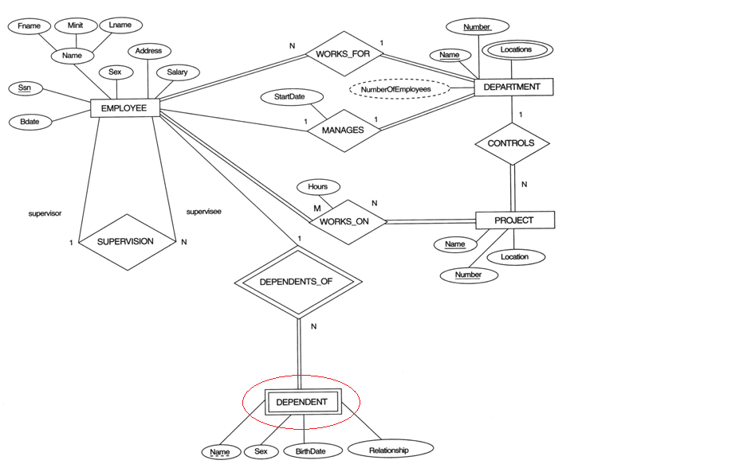
FIGURE 1.2 Mapping Weak Entity

Slide 20
ER-to-Relational Mapping Algorithm (cont)
Step 3: Mapping of Binary 1:1 Relation Types
For each binary 1:1 relationship type R in the ER schema, identify the relations S and T that correspond to the entity types participating in R.
Foreign Key approach: Choose one of the relations-S, say-and include a foreign key in S the primary key of T. It is better to choose an entity type with total participation in R in the role of S.
Example: 1:1 relation MANAGES is mapped by choosing the participating entity type DEPARTMENT to serve in the role of S, because its participation in the MANAGES relationship type is total.
Notes:
Merged relation option: An alternate mapping of a 1:1 relationship type is possible by merging the two entity types and the relationship into a single relation. This may be appropriate when both participations are total.

Slide 21
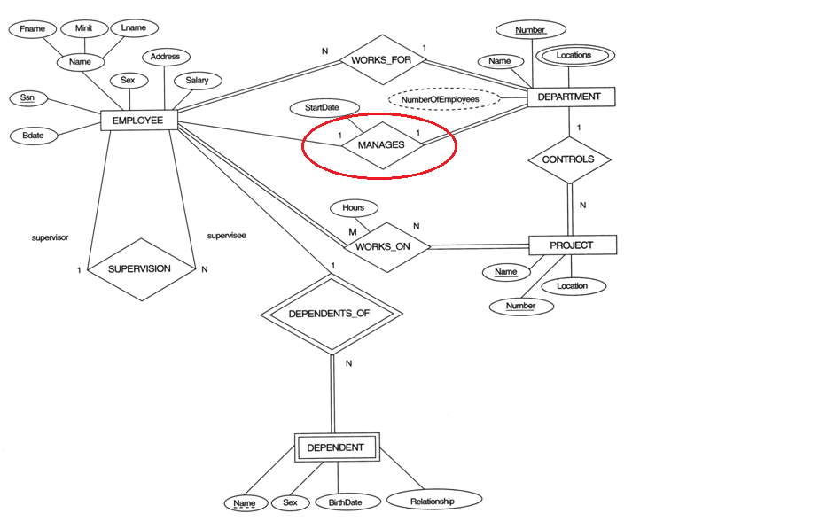
FIGURE 1.3 Mapping of Binary 1:1 Relationship Types.

Slide 22
ER-to-Relational Mapping Algorithm (cont)
Step 4: Mapping of Binary 1:N Relationship Types.
  For each regular binary 1:N relationship type R, identify the relation S that represent the participating entity type at the N-side of the relationship type.
  Include the primary key of the Parent relation T as foreign key in relation S (child relation) that represents the other entity type participating in R.
  Include any simple attributes of the 1:N relation type as attributes of S.
  Example: 1:N relationship types WORKS_FOR, CONTROLS, and SUPERVISION in the figure. For WORKS_FOR we include the primary key DNUMBER of the DEPARTMENT relation as foreign key in the EMPLOYEE relation and call it DNO.

Slide 23
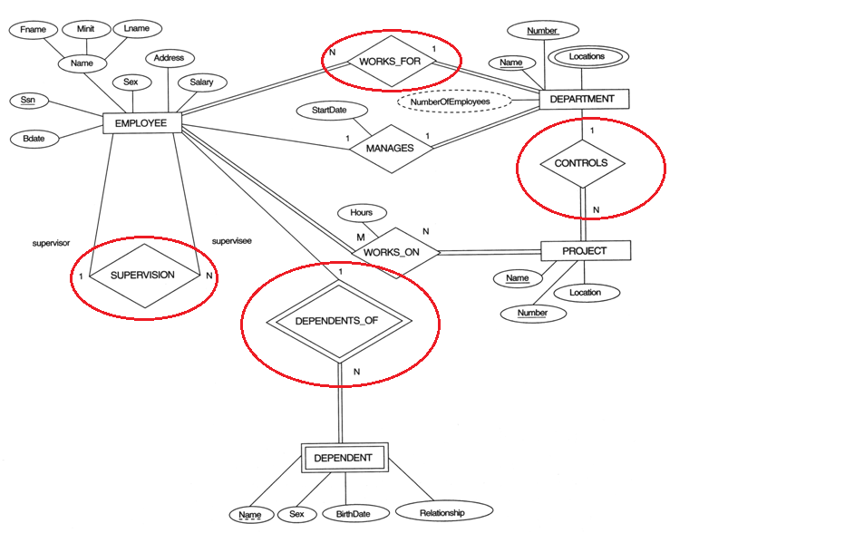

FIGURE 1.4 Mapping of Binary 1:N Relationship Types.

Slide 24
ER-to-Relational Mapping Algorithm (cont)
Step 5: Mapping of Binary M:N Relationship Types.
  For each regular binary M:N relationship type R, create a new relation S to represent R.
  Include as foreign key attributes in S the primary keys of the relations that represent the participating entity types; their combination will form the primary key of S.
  Also include any simple attributes of the M:N relationship type (or simple components of composite attributes) as attributes of S.
  Example: The M:N relationship type WORKS_ON from the ER diagram is mapped by creating a relation WORKS_ON in the relational database schema. The primary keys of the PROJECT and EMPLOYEE relations are included as foreign keys in WORKS_ON and renamed PNO and ESSN, respectively.
  Attribute HOURS in WORKS_ON represents the HOURS attribute of the relation type. The primary key of the WORKS_ON relation is the combination of the foreign key attributes {ESSN, PNO}.

Slide 25
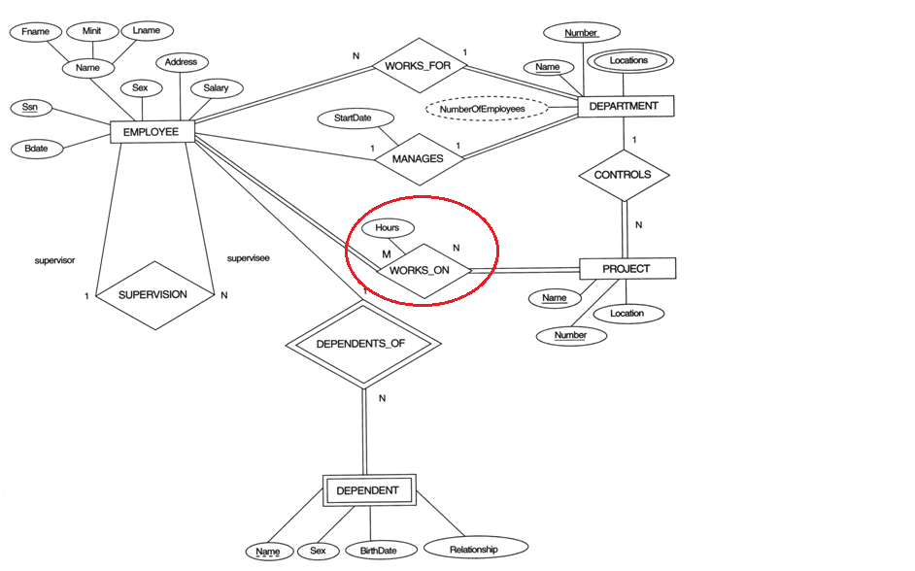
FIGURE 1. Mapping of Binary M:N Relationship Types.

Slide 26
ER-to-Relational Mapping Algorithm (cont)
Step 6: Mapping of Multivalued attributes.
  For each multivalued attribute A, create a new relation R. This relation R will include an attribute corresponding to A, plus the primary key attribute K-as a foreign key in R-of the relation that represents the entity type of relationship type that has A as an attribute.
  The primary key of R is the combination of A and K. If the multivalued attribute is composite, we include its simple components.
  Example: The relation DEPT_LOCATIONS is created. The attribute DLOCATION represents the multivalued attribute LOCATIONS of DEPARTMENT, while DNUMBER-as foreign key-represents the primary key of the DEPARTMENT relation. The primary key of R is the combination of {DNUMBER, DLOCATION}.

Slide 27
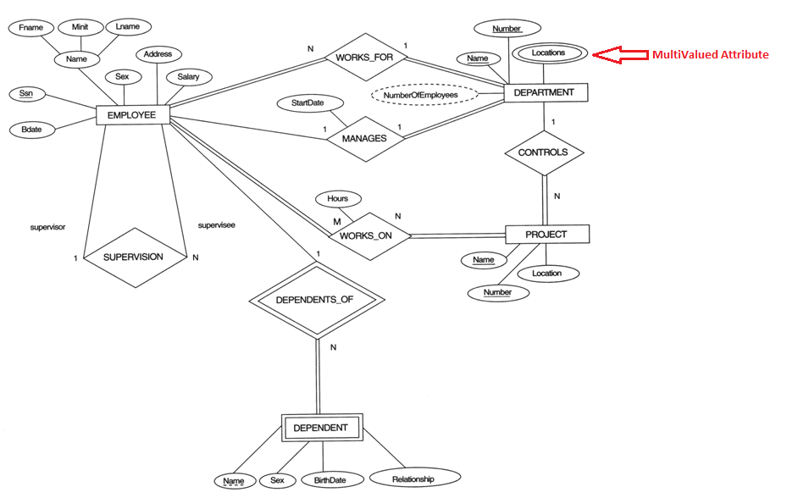
FIGURE 1.6 Mapping of Multivalued attributes

Slide 28

FIGURE 1.7
Result of mapping the COMPANY ER schema into a relational schema.

Slide 29
ER-to-Relational Mapping Algorithm (cont)
Step 7: Mapping of N-ary Relationship Types.
  For each n-ary relationship type R, where n>2, create a new relationship S to represent R.
  Include as foreign key attributes in S the primary keys of the relations that represent the participating entity types.
  Also include any simple attributes of the n-ary relationship type (or simple components of composite attributes) as attributes of S.
  Example: The relationship type SUPPY in the ER below. This can be mapped to the relation SUPPLY shown in the relational schema, whose primary key is the combination of the three foreign keys {SNAME, PARTNO, PROJNAME}

Slide 30

Ternary relationship types. (a) The SUPPLY relationship.

Slide 31

Mapping the n-ary relationship type SUPPLY from Figure 4.11a.

Slide 32
Summary of Mapping constructs and constraints
Table 7.1 Correspondence between ER and Relational Models
ER Model Relational Model
Entity type “Entity” relation
1:1 or 1:N relationship type Foreign key (or “relationship” relation)
M:N relationship type “Relationship” relation and two foreign keys
n-ary relationship type “Relationship” relation and n foreign keys
Simple attribute Attribute
Composite attribute Set of simple component attributes
Multivalued attribute Relation and foreign key
Value set Domain
Key attribute Primary (or secondary) key

Slide 33
MU EXAM QUESTION
ER to table mapping for different Problem Statement?

Slide 34
Exercise

Slide 35
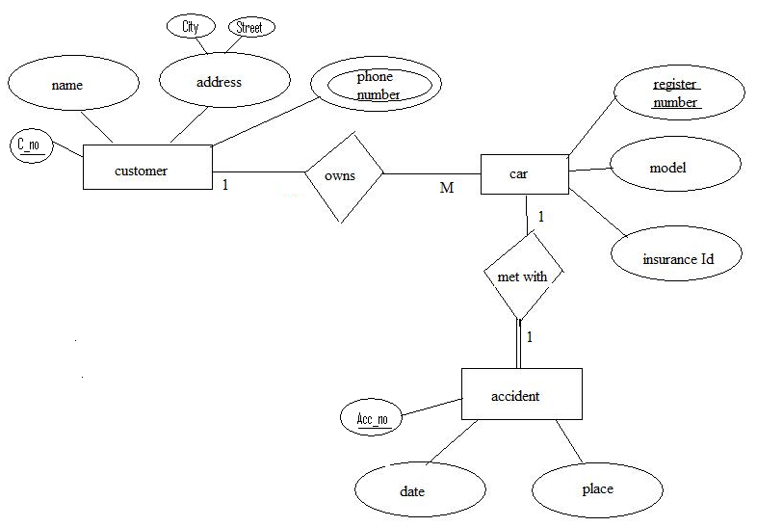
ER Diagram of Car Insurance Company

Slide 36
Relational Database Design by EER-to-Relational Mapping

Slide 37
Mapping EER Model Constructs to Relations
Step8: Options for Mapping Specialization or Generalization.
Convert each specialization with m subclasses {S₁, S₂,….,S_{m}} and generalized super class C, where the attributes of C are {k,a₁,…a_{n}} and k is the (primary) key, into relational schemas using one of the four following options:
Option 8A: Multiple relations-Superclass and subclasses.
Create a relation L for C with attributes Attrs(L) = {k,a₁,…a_{n}} and PK(L) = k. Create a relation L_{i} for each subclass S_{i}, 1 < i < m, with the attributes Attrs(L_{i}) = {k} U {attributes of S_{i}} and PK(L_{i})=k. This option works for any specialization (total or partial, disjoint or over-lapping).

Slide 38

FIGURE 1.8
EER diagram notation for an attribute-defined specialization on JobType.

Slide 39

Options for mapping specialization or generalization.
(a) Mapping the EER schema in Figure 4.4 using option 8A.
This option works for any specialization (total or partial, disjoint or over-lapping).

Slide 40
Mapping EER Model Constructs to Relations
Step8: Options for Mapping Specialization or Generalization.
Convert each specialization with m subclasses {S₁, S₂,….,S_{m}} and generalized super class C, where the attributes of C are {k,a₁,…a_{n}} and k is the (primary) key, into relational schemas using one of the four following options:
Option 8B: Multiple relations-Subclass relations only
Create a relation L_{i} for each subclass S_{i}, 1 < i < m, with the attributes Attr(L_{i}) = {attributes of S_{i}} U {k,a₁…,a_{n}} and PK(L_{i}) = k. This option only works for a specialization whose subclasses are total (every entity in the super class must belong to (at least) one of the subclasses).

Slide 41
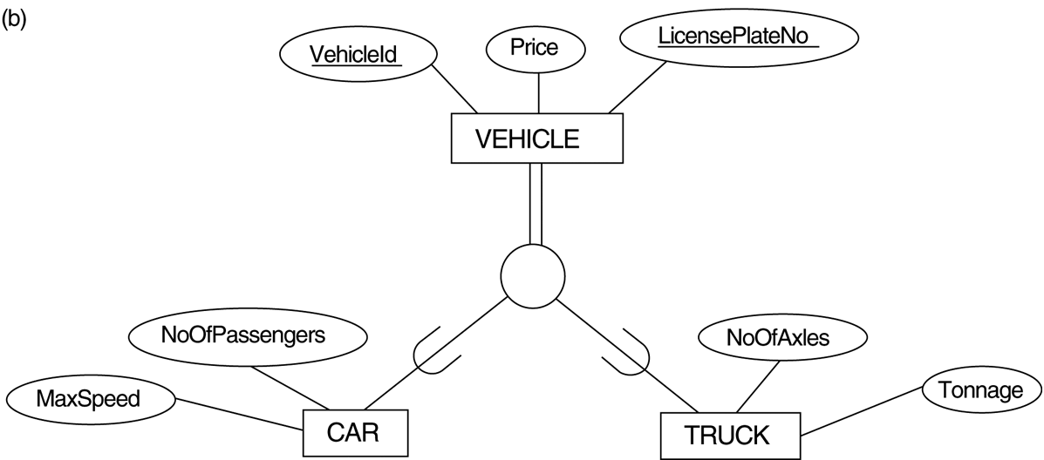
FIGURE 4.3
Generalization. (b) Generalizing CAR and TRUCK into the superclass VEHICLE.

Slide 42

FIGURE 7.4
Options for mapping specialization or generalization.
(b) Mapping the EER schema in Figure 4.3b using option 8B.
Tonnage
This option only works for a specialization whose subclasses are total (every entity in the super class must belong to (at least) one of the subclasses).

Slide 43
Mapping EER Model Constructs to Relations (cont)
Option 8C: Single relation with one type attribute.
Create a single relation L with attributes Attrs(L) = {k,a₁,…a_{n}} U {attributes of S₁} U…U {attributes of S_{m}} U {t} and PK(L) = k. The attribute “t” is called a type (or discriminating) attribute that indicates the subclass to which each tuple belongs

Slide 44
FIGURE 4.4
EER diagram notation for an attribute-defined specialization on JobType.

Slide 45
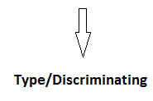

FIGURE 7.4
Options for mapping specialization or generalization.
(c) Mapping the EER schema in Figure 4.4 using option 8C.
Eng Type

Slide 46
Mapping EER Model Constructs to Relations (cont)
Option 8D: Single relation with multiple type attributes.
Create a single relation schema L with attributes Attrs(L) = {k,a₁,…a_{n}} U {attributes of S₁} U…U {attributes of S_{m}} U {t₁, t₂,…,t_{m}} and PK(L) = k. Each t_{i}, 1 < I < m, is a Boolean type attribute indicating whether a tuple belongs to the subclass S_{i}.

Slide 47

FIGURE 4.5
EER diagram notation for an overlapping (nondisjoint) specialization.
o

Slide 48
FIGURE 7.4
Options for mapping specialization or generalization.
(d) Mapping Figure 4.5 using option 8D with Boolean type fields Mflag and Pflag.

Slide 49
Mapping EER Model Constructs to Relations (cont)
Mapping of Shared Subclasses (Multiple Inheritance)
A shared subclass, such as STUDENT_ASSISTANT, is a subclass of several classes, indicating multiple inheritance. These classes must all have the same key attribute; otherwise, the shared subclass would be modeled as a category.
We can apply any of the options discussed in Step 8 to a shared subclass, subject to the restriction discussed in Step 8 of the mapping algorithm. Below both 8C and 8D are used for the shared class STUDENT_ASSISTANT.

Slide 50
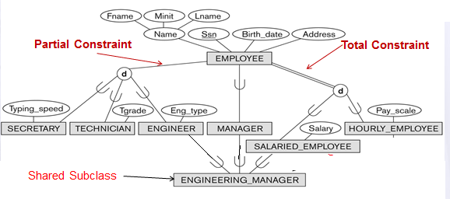
A specialization lattice Example with multiple inheritance

Slide 51
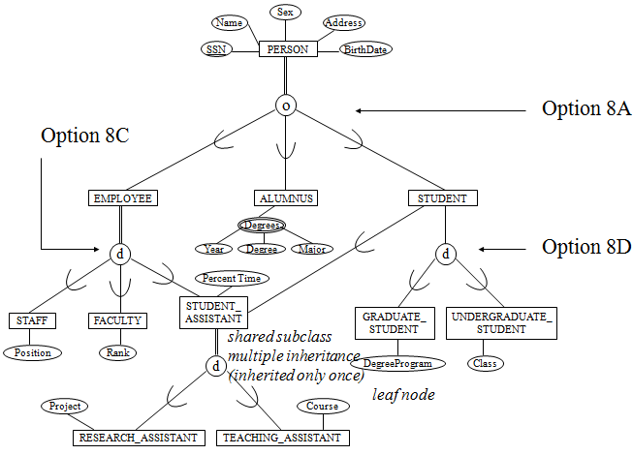
A specialization lattice with multiple inheritance for a UNIVERSITY database.

Slide 52
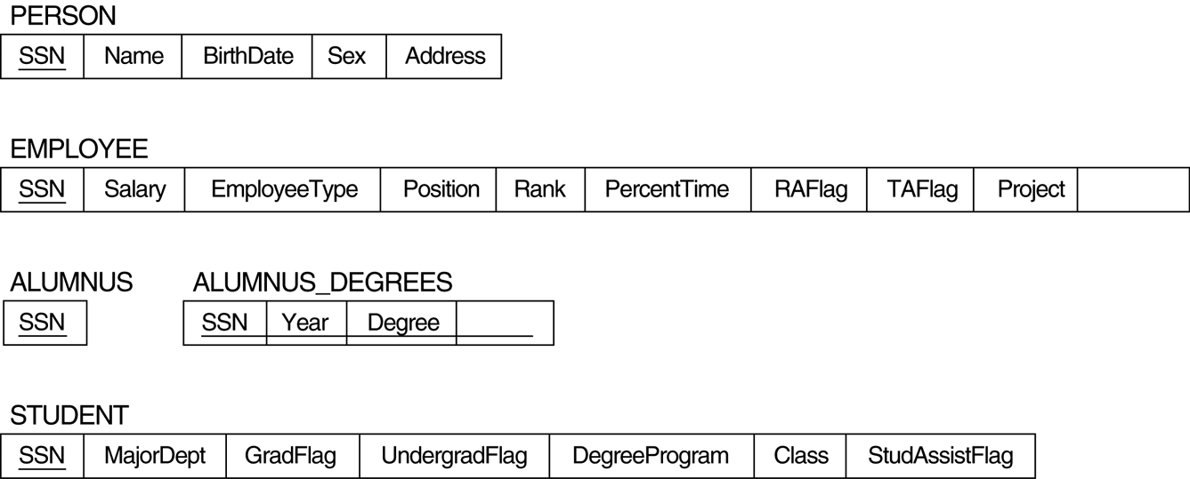
FIGURE 7.5
Mapping the EER specialization lattice in Figure 4.6 using multiple options.
course
major

Slide 53
Mapping EER Model Constructs to Relations (cont)
Step 9: Mapping of Union Types (Categories).
  For mapping a category whose defining super class have different keys, it is customary to specify a new key attribute, called a surrogate key, when creating a relation to correspond to the category.
  In the example below we can create a relation OWNER to correspond to the OWNER category and include any attributes of the category in this relation. The primary key of the OWNER relation is the surrogate key, which we called OwnerId.

Slide 54

FIGURE 4.8
Two categories (union types): OWNER and REGISTERED_VEHICLE.

Slide 55
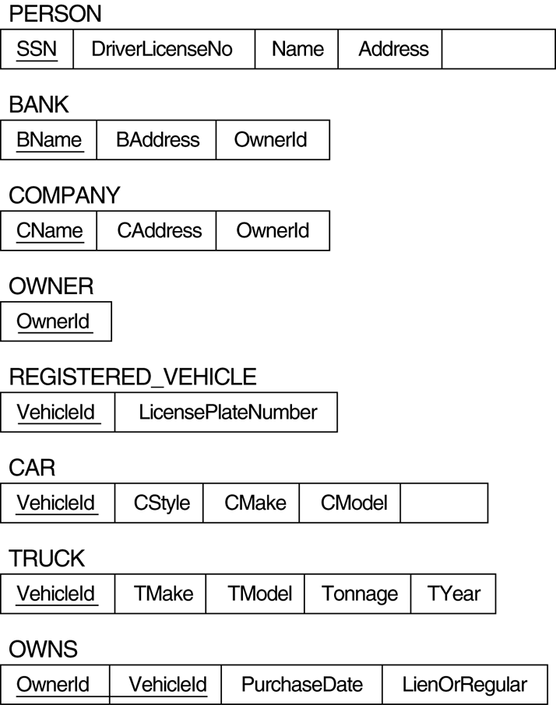
FIGURE 7.6
Mapping the EER categories (union types) in Figure 4.7 to relations.
OwnerId
CYear

Slide 56
Relational Data Integrity

Slide 57
Relational Integrity
Null
  Represents a value for an attribute that is currently unknown or is not applicable for this tuple.
  Deals with incomplete or exceptional data.
  Null represents the absence of a value and is not the same as zero or spaces, which are values.
22

Slide 58
Relational Integrity
Entity Integrity:
  In a base relation, no attribute of a primary key can be null.
Referential Integrity
  If a foreign key exists in a relation, either the foreign key value must match a candidate key value of some tuple in its home relation or the foreign key value must be wholly null.
Domain Constraints
  All values appearing in a column must be taken from the same domain.
Enterprise or Business Constraints
  Additional rules specified by policies, users, or database administrators.
23

Slide 59
Relational Algebra and its Queries

Slide 60
Relational Algebra
  Relational Algebra: More Operational (Procedural), very useful for representing execution plans.
3 basic operators
  Unary Operator
  Binary Operator
  Set Operator
The operators take one or two relations as inputs and produce a new relation as a result.

Slide 61
RELATIONAL ALGEBRA
Unary Operators
Select: σ
Project: ∏
Rename: ρ

Slide 62
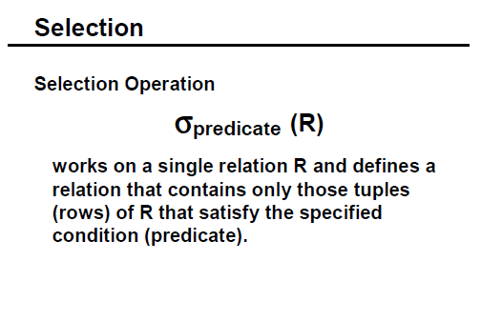

Slide 63
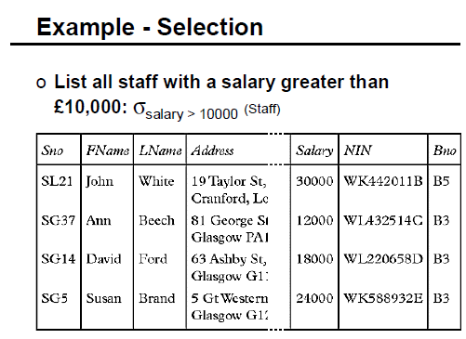

Slide 64
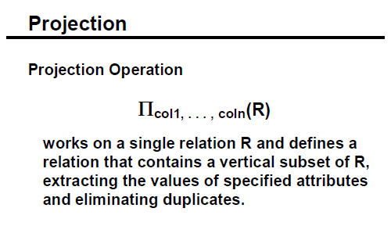

Slide 65
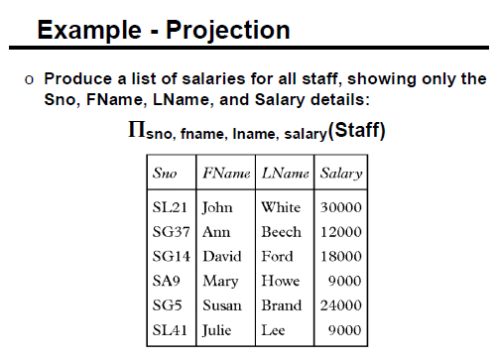

Slide 66
Composition of Operations
∏_{customer_name} (σ _{customer_city} _{= “Harrison”} (customer))
Select customer_name
from customer
where customer_city=“Harrison”;

Slide 67

Rename Operation
Allows us to name, and therefore to refer to, the results of relational-algebra expressions.
Allows us to refer to a relation by more than one name.
Example:
ρ _{x} (E)
returns the expression E under the name X
If a relational-algebra expression E has arity n, then
returns the result of expression E under the name X, and with the
attributes renamed to A₁ , A₂ , …., A_{n} .

Slide 68
Exercise
Select *
From Students
Where course = ‘Computing’;
Select stud#, name
From Students;
Select stud#, name
From students
Where course = ‘Computing’;

Slide 69
Unary Operations in SQL
Selection
σ _{course = ‘Computing’} Students
In SQL:
Select *
From Students
Where course = ‘Computing’;
Projection
π _{stud#, name} Students
In SQL:
Select stud#, name
From Students;
Selection & Projection
π _{stud#, name} (σ _{course = ‘Computing’} Students)
In SQL:
Select stud#, name
From students
Where course = ‘Computing’;

Slide 70
RELATIONAL ALGEBRA
Binary Operators
Cartesian Product
Joins

Slide 71
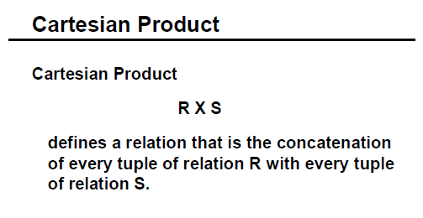

Slide 72
Cartesian-Product Operation – Example
Relations r, s:
A
B
C
D
E
α
β
1
2
α
β
β
γ
10
10
20
10
a
a
b
b
r
s
r x s:
A
B
C
D
E
α
α
α
α
β
β
β
β
1
1
1
1
2
2
2
2
α
β
β
γ
α
β
β
γ
10
10
20
10
10
10
20
10
a
a
b
b
a
a
b
b

Slide 73
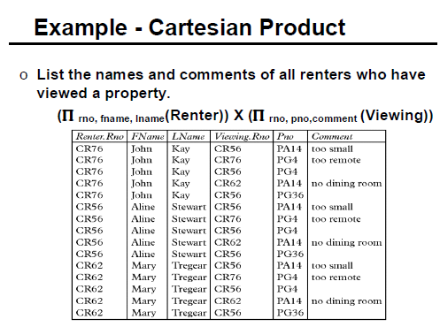

Slide 74
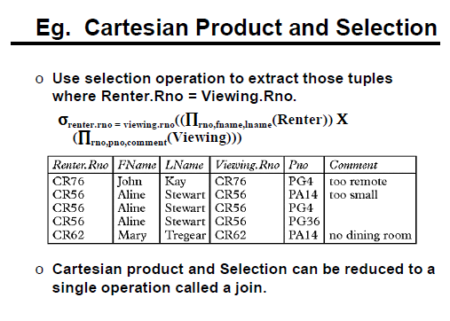

Slide 75
Joins
Joining data together is one of the most significant strengths of a relational database.
A join is a query that combines rows from two or more relations.
Tables are “joined” two at a time making a new relation (a table generated on the fly) containing all possible combinations of rows from the original two tables (sometimes called a “Cross Join” or “Cartesian product”).
Joins can be expressed as a Cartesian product followed by a selection

Slide 76



Cartesian Product: instructor X teaches
instructor
teaches

Slide 77
Types of Join Operations:-
Cross Join
Theta Join
Equi Join
Natural Join
Inner Join
Outer Join
Self Join
N-Way Join
Left Outer Join
Right Outer Join
Full Outer Join

Slide 78
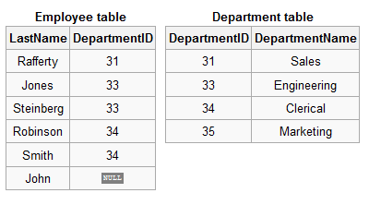

Slide 79
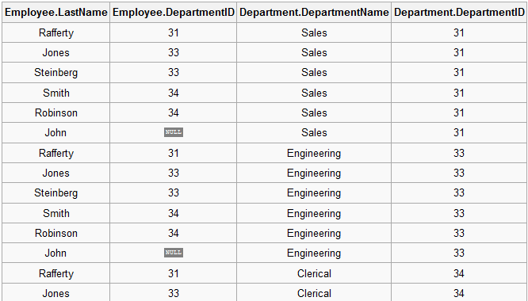
1. Cross Join- R X S
CROSS JOIN returns the Cartesian product of rows from tables in the join. In other words, it will produce rows which combine each row from the first table with each row from the second table.
Explicit cross join:
SELECT * FROM employee
CROSS JOIN department;
Implicit cross join:
SELECT * FROM
employee, department;

Slide 80
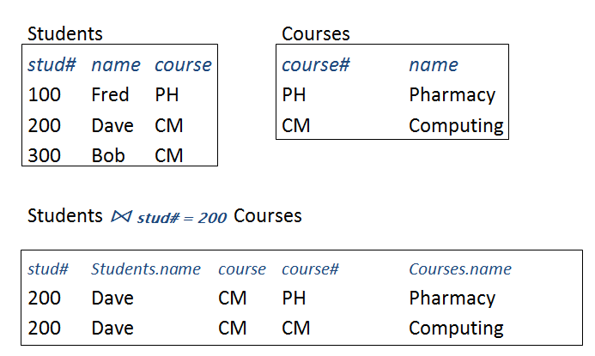
2. Theta Join- A Cartesian product with a condition.
R ⋈ <condition> S

Slide 81
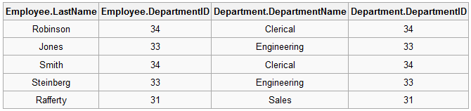
3. Equi Join(R⋈ _{<PK = FK>} S)
Most joins are “equi-joins” where the data from a column in one table exactly matches data in the column of another table. (P.K & F.K)
SELECT * FROM
Employee e, department d WHERE
e.DepartmentID = d.DepartmentID;

Slide 82
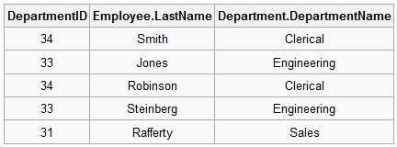
4. Natural Join (R⋈ _{<PK = FK>} S)
Natural join is basically an equijoin followed by removal of the superfluous attributes.
SELECT * FROM employee
NATURAL JOIN department;

Slide 83
5. Inner Join
An inner join is a join with a join condition that may contain both equality or non-equality sign
  whereas an equijoin is a join with a join condition that only contain only equality sign.
  So we can say an equijoin is a type of inner join containing (Equal)= operator in the join condition.
It is good to know the difference between join and INNER JOIN keyword.
  Actually there is no difference: If we write JOIN then by default INNER JOIN is performed.
The following example will make you more clear.

Slide 84
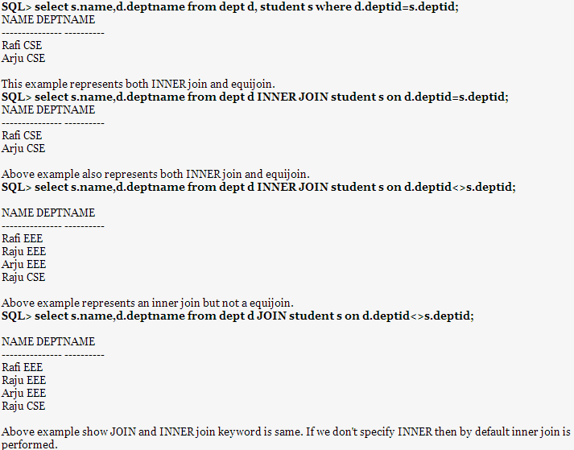

Slide 85
6. Outer Join
An outer join does not require each record in the two joined tables to have a matching record.
The joined table retains each record—even if no other matching record exists.
Outer joins subdivide further into left outer joins, right outer joins, and full outer joins, depending on which table's rows are retained (left, right, or both).
Left Outer Join
Right Outer Join
Full Outer Join

Slide 86
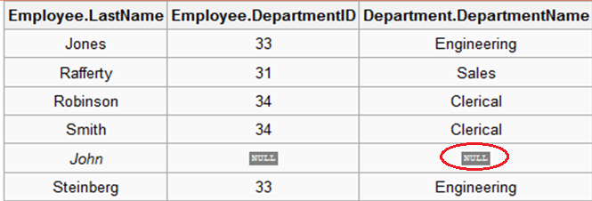
6.1 Left Outer Join R _{<R.PK = S.FK>} S
The result of a left outer join (or simply left join) for table A and B always contains all records of the "left" table (A), even if the join-condition does not find any matching record in the "right" table (B).
SELECT * FROM employee e
LEFT OUTER JOIN department d
ON
e.DepartmentID = d.DepartmentID;

Slide 87
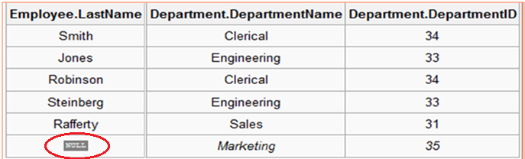
6.2 Right Outer Join R _{<R.PK = S.FK>} S
Every row from the "right" table (B) will appear in the joined table at least once. If no matching row from the "left" table (A) exists, NULL will appear in columns from A for those records that have no match in B.
SELECT * FROM employee e
Right OUTER JOIN department d
ON
e.DepartmentID = d.DepartmentID;

Slide 88
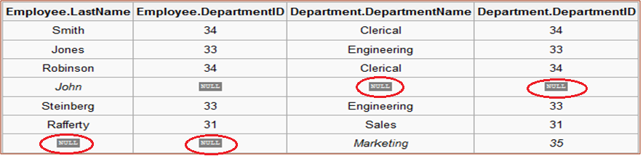
6.3 Full Outer Join
A full outer join combines the effect of applying both left and right outer joins.
Where records in the FULL OUTER Joined tables do not match, the result set will have NULL values for every column of the table that lacks a matching row. For those records that do match, a single row will be produced in the result set (containing fields populated from both tables).
SELECT * FROM employee e
Full OUTER JOIN department d
ON
e.DepartmentID = d.DepartmentID;

Slide 89
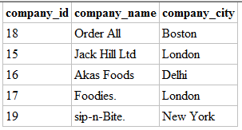


7. Self Join-A self-join is joining a table to itself

Slide 90
8. N-Way Join or Multi Join
The Natural Join or Equi Join operation can be specified among multiple tables, leading to an n-way join.
E.g.: consider the following 3 way join.
Customer, Accounts, Loan

Slide 91
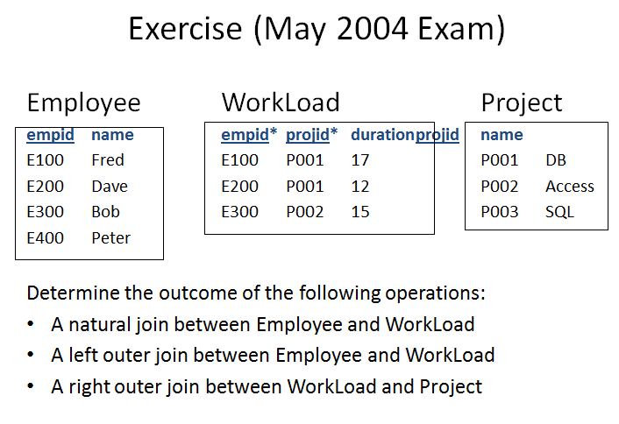

Slide 92
RELATIONAL ALGEBRA
Set Operators
Union
Intersection
Set difference

Slide 93
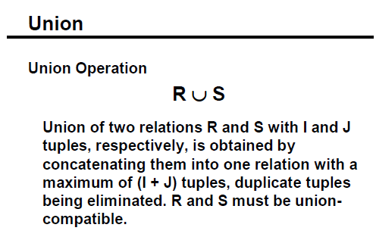

Slide 94
Union Operation – Example
Relations r, s:
A
B
A
B
α
α
β
1
2
1
α
β
2
3
s
r
r ∪ s:
A
B
α
α
β
β
1
2
1
3

Slide 95
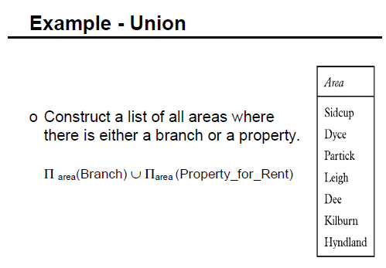

Slide 96
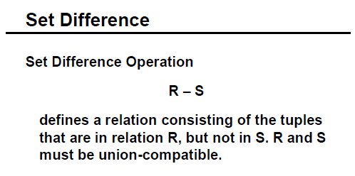

Slide 97
Set Difference Operation – Example
Relations r, s:
A
B
A
B
α
α
β
1
2
1
α
β
2
3
s
r
r – s:
A
B
α
β
1
1

Slide 98
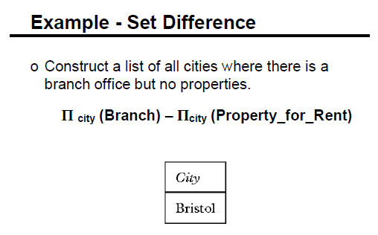

Slide 99
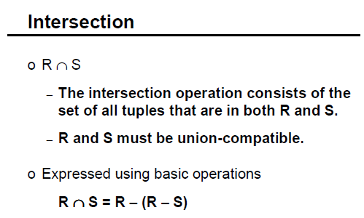
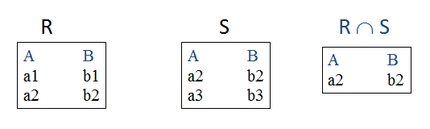

Slide 100
Set Operations in SQL
Union: R ∪ S
In SQL:
Select * From R
Union
Select * From S;
Intersection: R ∩ S
In SQL:
Select * From R
Intersect
Select * From S;
Difference: R - S
In SQL:
Select * From R
Minus
Select * From S;

Slide 101
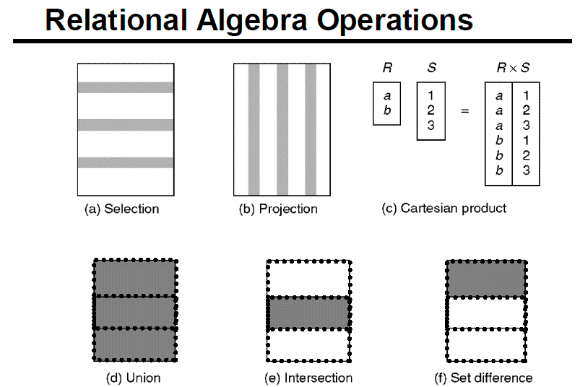

Slide 102
Extended Relational-Algebra-Operations
Generalized Projection
Division

Slide 103
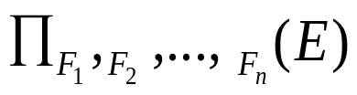
Generalized Projection
Extends the projection operation by allowing arithmetic functions to be used in the projection list.
E is any relational-algebra expression
Each of F₁, F₂, …, F_{n} are arithmetic expressions involving constants and attributes in the schema of E.
Given relation credit_info(customer_name, limit, credit_balance), find how much more each person can spend:
∏customer_name, limit – credit_balance (credit_info)

Slide 104
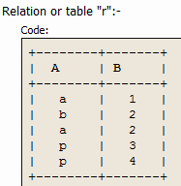
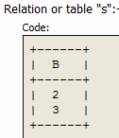
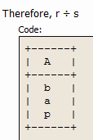
DIVISION OPERATION (r ÷ s)
The result consists of the restrictions of tuples in r to the attribute names unique to R, i.e. in the Header of r but not in the Header of S, for which it holds that all their combinations with tuples in s are present in r.

Slide 105
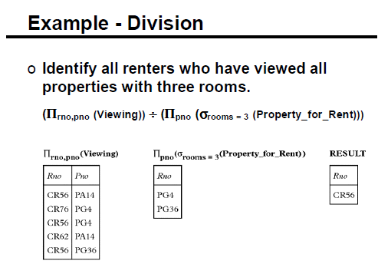
CR76

Slide 106
EXERCISE ON OPERATORS

Slide 107
Loan
Account
L_no | L_amt | Branch
L001 | 1 Lakh | Perriyridge
L002 | 1Lakh | Redmount
L003 | 2 Lakh | HillPark
Acc_no | Acc_bal
A001 | 10000
A002 | 20000
A003 | 30000
Borrower
Depositor
L_no | C_name
L001 | John
L001 | Stephy
L002 | Rahul
L003 | Marry
C_name | C_Id | Acc_no
John | C001 | A001
Stephy | C002 | A001
Carl | C003 | A002
Tina | C004 | A003

Slide 108
Example Queries
1. Find all loans of over $1200
σamount > 1200 (loan)
2. Find the loan number for each loan of an amount greater than $1200
∏loan_number (σamount > 1200 (loan))
3. Find the names of all customers who have a loan, an account, or both, from the bank
  ∏_{customer_name} (borrower) ∪ ∏_{customer_name} (depositor)

Slide 109
Example Queries
4. Find the names of all customers who have a loan at the Perryridge branch.
∏_{customer_name} (σ_{branch_name=“Perryridge”}
(σborrower.loan_number = loan.loan_number(borrower x loan)))
5. Find the names of all customers who have a loan at the Perryridge branch but do not have an account at any branch of the bank.
∏customer_name (σbranch_name = “Perryridge”(σborrower.loan_number = loan.loan_number(borrower x loan))) – ∏customer_name(depositor)

Slide 110
Relational Calculus
  Relational Calculus: Lets users describe what they want, rather than how to compute it: Non-operational, declarative.

Slide 111
Relational Calculus
Relational calculus query specifies what is to be retrieved rather than how to retrieve it.
  No description of how to evaluate a query.
In first-order logic (or predicate calculus), predicate is a truth-valued function with arguments.
When we substitute values for the arguments, function yields an expression, called a proposition, which can be either true or false.
If predicate contains a variable (e.g. ‘x is a member of staff’), there must be a range for x.
When we substitute some values of this range for x, proposition may be true; for other values, it may be false.
When applied to databases, relational calculus has forms: Tuple and domain.
Pearson Education © 2009

Slide 112
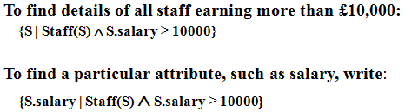
1. Tuple Relational Calculus
Interested in finding tuples for which a predicate is true. Based on use of tuple variables.
Tuple variable is a variable that ‘ranges over’ a named relation: i.e., variable whose only permitted values are tuples of the relation.
Specify range of a tuple variable S as the Staff relation as:
  Staff(S)
To find set of all tuples S such that P(S) is true:
  {S | P(S)}
Pearson Education © 2009

Slide 113
Tuple Relational Calculus
Can use two quantifiers to tell how many instances the predicate applies to:
  Existential quantifier ∃ (‘there exists’)
  Universal quantifier ∀ (‘for all’)
Tuple variables qualified by ∀ or ∃ are called bound variables, otherwise called free variables.
Existential quantifier used in formulae that must be true for at least one instance, such as:
  Staff(S) ∧ (∃B)(Branch(B) ∧ (B.branchNo = S.branchNo) ∧ B.city = ‘London’)
Means ‘There exists a Branch tuple with same branchNo as the branchNo of the current Staff tuple, S, and is located in London’.
Pearson Education © 2009

Slide 114
Tuple Relational Calculus
Universal quantifier is used in statements about every instance, such as:
  (∀B) (B.city ≠ ‘Paris’)
Means ‘For all Branch tuples, the address is not in Paris’.
Can also use ~(∀B) (B.city = ‘Paris’) which means ‘There are no branches with an address in Paris’.
Pearson Education © 2009

Slide 115
Example - Tuple Relational Calculus
List the names of all managers who earn more than £25,000.
  {S.Name | Staff(S) ∧
  S.position = ‘Manager’ ∧ S.salary > 25000}
List the staff who manage properties for rent in Mumbai.
  {S | Staff(S) ∧ (∀P) (PropertyForRent(P) ∧ (P.SNo = S.SNo) Ù P.city = ‘Mumbai’)}
Name | Position | Salary
Sachin | Manager | 50000
Robin | Clerk | 35000
Pratap | Secretary | 25000
Staff
PropertyforRent
Sno | SName | City
S001 | Sachin | Mumbai
S002 | Robin | Pune
S003 | Pratap | Chennai
Pno | SNo | City
P001 | S001 | Mumbai
P002 | S001 | Pune
P003 | S002 | Mumbai
Pearson Education © 2009

Slide 116

Example - Tuple Relational Calculus
3. List the names of staff who currently do not manage any properties.
  {S.Name | Staff(S) ∧ (~(∀ P) (PropertyForRent(P)∧(S.SNo = P.SNo)))}
  Or
  {S.Name | Staff(S) ∧ ((∀P) (~PropertyForRent(P) ∨ ~(S.SNo = P.SNo)))}
Pearson Education © 2009

Slide 117
Tuple Relational Calculus
Expressions can generate an infinite set. For example:
  {S | ~Staff(S)}
To avoid this, add restriction that all values in result must be values in the domain of the expression.
Pearson Education © 2009

Slide 118
2. Domain Relational Calculus
Uses variables that take values from domains instead of tuples of relations.
If F(d₁, d₂, . . . , d_{n}) stands for a formula composed of atoms and d₁, d₂, . . . , d_{n} represent domain variables, then:
  {d₁, d₂, . . . , d_{n} | F(d₁, d₂, . . . , d_{n})}
  is a general domain relational calculus expression.
Pearson Education © 2009

Slide 119
Example - Domain Relational Calculus
Find the names of all managers who earn more than £25,000.
  (Tuple Calculus):
  {S.Name | Staff(S) ∧ S.position = ‘Manager’ ∧ S.salary > 25000}
  {N | (N, P, D, S) (Staff (Name, position,DOB, salary) ∧ position = ‘Manager’ ∧ salary > 25000)}
List the staff who manage properties for rent in Mumbai.
  (Tuple Calculus):
  {S | Staff(S) ∧ (∀ P) (PropertyForRent(P) ∧ (P.SNo = S.SNo) Ù P.city = ‘Mumbai’)}
  {N, P, D, S | (∃ S1, C1) (N, P,D,S)(Staff(Sno, N, position, DOB, salary) ∧ (P1, S1, C1)PropertyForRent(PNo, Sn1, City) ∧ (Sno=Sn1) ∧ city=‘Mumbai’)}
Pearson Education © 2009

Slide 120
Example - Domain Relational Calculus
3. List the names of staff who currently do not manage any properties for rent.
    (Tuple Calculus):
    {S.Name | Staff(S) ∧ (~(∀ P) (PropertyForRent(P)∧(S.SNo = P.SNo)))}
  {N | (∀ S, N, P, D, S1) (Staff(Sno, Name, posn,DOB, sal) ∧ (~(∀ S2) (P1,C, S2) (PropertyForRent(Pno, city, PSno) ∧ (Sno=PSno))))}
Pearson Education © 2009

Slide 121
Domain Relational Calculus
When restricted to safe expressions, domain relational calculus is equivalent to tuple relational calculus restricted to safe expressions, which is equivalent to relational algebra.
Means every relational algebra expression has an equivalent relational calculus expression, and vice versa.
Pearson Education © 2009

Slide 122
Thank You All....
If any doubts Please do clear it....!!!!

